Slide 1
CHRO Roundtable:
How Has HR Evolved Over the Last Year,
and What Does It Look Like Going Forward?

Slide 2

How Has HR Evolved Over the Last Year,
and What Does It Look Like Going Forward?
McLean & Company is a research and advisory firm providing practical solutions to human resources challenges via executable research, tools, and advice that have a clear and measurable impact on your business.
Our research team uses a rigorous research process to identify and hone best practices; create practical tools, templates, and policies; and supply clients with the insight and guidance of our subject matter experts. McLean & Company applies this proven research approach to both human resources and company management teams, creating complete solutions that supply the tools you need to get each project done right.
McLean & Company analysts bring real-world experience to the table and apply their knowledge to solving the challenges faced by our clients on a daily basis. This process is informed by the participation of a client base that includes over 30,000 members and by an evolving client-driven research agenda.
McLean & Company is a division of Info-Tech Research Group Inc.

Slide 3
How Has HR Evolved Over the Last Year,
and What Does It Look Like Going Forward?
Housekeeping
Use the Q&A function to post questions.
We will select a few common questions to be answered by our panelists at the end of the session.
We will send out the slides and a recording to all participants after the webinar.
McLean & Company | 3

Slide 4
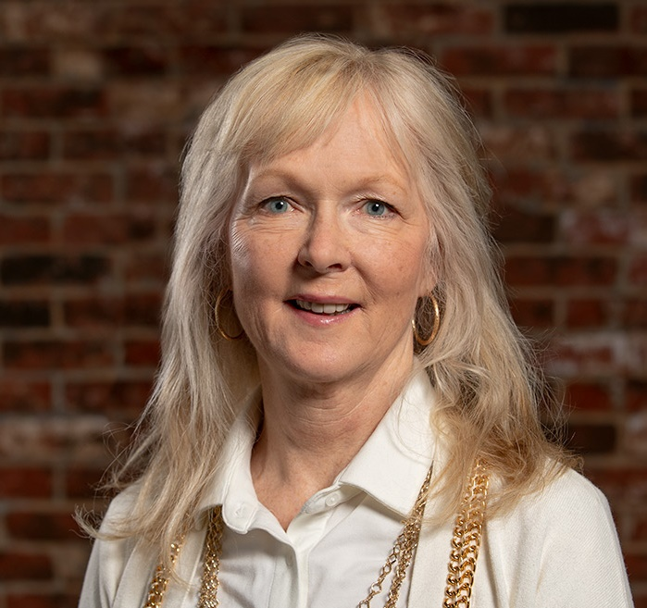

How Has HR Evolved Over the Last Year,
and What Does It Look Like Going Forward?
Who we are
Mardi Walker
Executive Counselor
Evan Hughes
Director, HR Research & Advisory Services

Slide 5

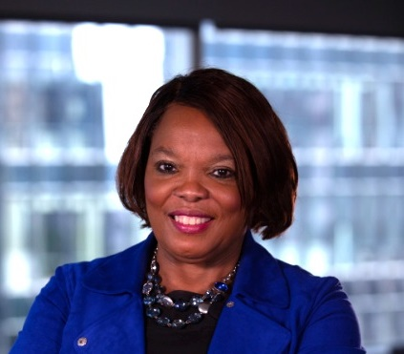
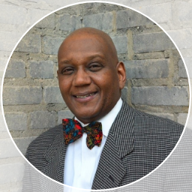
How Has HR Evolved Over the Last Year,
and What Does It Look Like Going Forward?
Who we are
S. Jamila Buckner
Chief People Officer
Accion Opportunity Fund
Sharon Grant
Vice President of HR
Virginia Economic Development Partnership
Michael McRath
Chief Human Resource Officer
Catholic Charities of St. Paul and Minneapolis

Slide 6
How Has HR Evolved Over the Last Year,
and What Does It Look Like Going Forward?
Webinar Objectives
Share insights from McLean & Company’s research on the major impacts on HR over the past year
01
Hear thoughts and advice from three HR executives on these impacts and the change to HR
02
Be more prepared to address the impact and change these have had on HR in your own organizations
03
McLean & Company | 6

Slide 7
How has HR changed over the past year?

Slide 8

Diversity, Equity, and Inclusion
MCLEAN & COMPANY
McLean & Company | 8

Slide 9



How Has HR Evolved Over the Last Year,
and What Does It Look Like Going Forward?
The social movements of 2020 changed the conversation around DEI
The Business Case for Inclusive Organizations
Percent of Organizations Taking Action to Create an Environment of DEI
Larger revenue growth
Achieve 3x the revenue growth compared to less inclusive organizations.
94%
(Bush et al., 2018)
75%
Better performance than peers
The performance differential between the most and least gender-diverse organizations is 48%.
(McKinsey, 2018)
More positive employee experience
18% more effective at creating a positive employee experience.
2020
2021
n=439
n=415
(McLean & Company Trends Report, 2020; N=416)
McLean & Company Trends Report, 2020, 2021

Slide 10
How Has HR Evolved Over the Last Year,
and What Does It Look Like Going Forward?
Yet DEI practices with the greatest impact are being overlooked
Despite increased focus and prioritization, many of the actions taken are quick wins, with increased emphasis on speed rather than impact. However, the critical practices associated with higher organizational performance and/or DEI performance remain largely unchanged.
Change year-over-year
Identifying and addressing pay gaps (or inequities) for underrepresented groups
3%
Organizational performance
Embedding inclusive behaviors into values or competencies
0%
-2%
Evaluating inclusive leadership behaviors as part of the performance appraisal process
DEI performance
Clearly articulating the link between DEI and organizational goals
-1%
Structuring interviews to mitigate bias
4%
McLean & Company Trends Report, 2021; n=415

Slide 11
How Has HR Evolved Over the Last Year,
and What Does It Look Like Going Forward?
How will the focus on DEI change the way HR operates?
What will it take to sustain the prioritization of DEI?
DEI

Slide 12
Remote Work
MCLEAN & COMPANY
McLean & Company | 12

Slide 13



How Has HR Evolved Over the Last Year,
and What Does It Look Like Going Forward?
Over a year of remote work has challenged many of the traditional barriers
ORGANIZATIONS
LEADERS
EMPLOYEES
Concerns that WFH may stifle innovation (The Economist, 2020) likely due to the potential lack of collaboration and knowledge sharing.
Fewer organic opportunities for informal interaction between employees working from home means active efforts are required to foster organizational culture.
42% of managers believe that monitoring the productivity of their direct reports is a top challenge of WFH (Ultimate Software, 2019).
The lack of in-person supervision compounded with a lack of trust in employees leads many leaders to believe that WFH will result in a drop in productivity.
20% of employees report collaboration/communication as their top struggle with WFH (Buffer & AngelList, 2020).
Employees often experience burnout from working longer hours due to the lack of commute, blurring of work and home life, and the perceived need to prove their productivity.

Slide 14

How Has HR Evolved Over the Last Year,
and What Does It Look Like Going Forward?
COVID-19 has changed the work-from-home (WFH) landscape
More than 9 out of 10 organizations are planning to implement or continue some form of WFH in 2021 (McLean & Company, 2021 HR Trends Report; N=428).
87%
of organizations say they will embrace greater flexibility post-pandemic, with most planning a hybrid onsite/remote-work model (Mercer, 2021).
71%
of IT leaders report improved attitudes toward WFH policies, which will likely impact their planning of office space and staffing in the future (IDG, 2020).
86%
of employees expect WFH to become the future of work (GitLab, 2020).
Perception of WFH has shifted
36%
of employees believe organizations will be open to WFH options after the pandemic (One Poll & Citrix, 2020).
28%
of organizations plan on making the WFH arrangements permanent for some employees after the pandemic (Human Resource Executive, 2020).
60%
of employees are confident in their ability to perform in their roles should they be required to WFH indefinitely (Glassdoor, 2020).

Slide 15
How Has HR Evolved Over the Last Year,
and What Does It Look Like Going Forward?
What else has remote work changed or challenged?
Does HR still have to champion remote work?
What does remote work mean for HR structures and workflows?
Remote work

Slide 16
Shifting priorities
MCLEAN & COMPANY
McLean & Company | 16

Slide 17
How Has HR Evolved Over the Last Year,
and What Does It Look Like Going Forward?
The pandemic changed the way HR balanced priorities
How has the pandemic changed the way HR balances employee needs with organizational needs?
When there was a greater focus on employee needs rather than organizational needs since the pandemic, organizations were:
There has been a shift toward HR balancing employee needs with organizational needs more since the pandemic.
Yet 22% of organizations have a greater focus on organizational needs over employee needs.
1.5x
More likely to be high performing in overall organizational performance
n=426
1.4x
More likely to be high performing in workforce productivity
n=445
n=421
Source: McLean & Company Trends Report, 2021

Slide 18
How Has HR Evolved Over the Last Year,
and What Does It Look Like Going Forward?
HR has a seat at the table, but what comes next?
How is HR involved in the broader organizational strategy?
44%
report HR as being a partner
8 percentage points
increase compared to 2020.
n=758
When HR is a partner, organizations are
more likely to be highly effective at quickly changing to capitalize on new ideas.
1.7x
n=790
n=710
n=854
n=718
n=758
n=745
A partner in planning and executing strategy
Asked for input into planning, involved in executing strategy
Involved in executing strategy after it is developed
Not involved with the strategy
Source: McLean & Company Trends Report, 2021

Slide 19
The pandemic thrust HR into the spotlight. Is that here to stay?
Pushing ahead
Is the employee experience or organizational needs a bigger priority for HR?
How will technology change the composition of HR teams?
How does HR move from a business partner to a business leader?

Slide 20
How Has HR Evolved Over the Last Year,
and What Does It Look Like Going Forward?
Q&A
Time for a few questions…

Slide 21


Thank you!
For information on McLean & Company’s products and services, please contact:
​
Jon Campbell​
jcampbell@mcleanco.com

Slide 22

Selected resources
2021 HR Trends Report
Create a People-First Diversity, Equity & Inclusion Strategy
Embed Inclusion Into Your Culture
The Pandemic’s Impact on Career Plans
Sustain Work-From-Home in the New Normal
Create a Talent Strategy
Systematically Develop Your HR Department
Build a Resilient HR Team
Redesign Your HR Structure

Slide 23





Leadership Membership
The Leadership Membership Difference
This membership will give you the tools you need to push your HR department further, faster. Complete major projects with the help of a dedicated Executive Advisor who is a former HR Leader.
You’ll get a dedicated Executive Advisor, who is a former HR leader who will meet with you quarterly. Their experience will benefit you as you work toward delivering key initiatives. They can help you prioritize projects, mitigate challenges, direct you to the relevant research or subject matter experts, and keep you on track.
Boost your own development with one 360-Degree Feedback personal evaluation, including one debrief session and a separate development planning session.
Kick-start an important project with a half-day online advisory session. Your Executive Advisor or a relevant subject matter expert will facilitate one of ten different sessions.
Your choice of one ticket to McLean & Company’s Signature Conference or one ticket to our virtual Elevate HR strategic leadership development course. Ideally, we’d like you to benefit from these events, although the ticket could be transferred to a colleague.
Save money and obtain peace of mind from our HR technology vendor management and contract review services. This helps you assess, manage, and reduce costs while strengthening vendor relationships.

Slide 24




Counselor Seat Services
The Counselor Membership Difference Features:
You’ll get a dedicated Counselor who is a
former Senior HR Executive and has been in your shoes.
You will benefit from two online advisory sessions throughout the year (along with unlimited scheduled and ad hoc phone calls) that integrate your Counselor as a trusted part of your professional support network. Use these meetings to cover anything you’d like, from prioritizing your own development to working through a project.
Leverage your personal Executive Counselor to make your personal and professional development a priority.
Your customized Personal Leadership Development Plan created with your trusted Executive Counselor will link to your personal and organizational goals and values.
You’ll develop a custom, authentic Leadership Brand which allows you to thrive and better market your unique value proposition.
Your Counselor can help you navigate board- or executive-level challenges and prepare for meetings.
Plus all the benefits of a Leadership Membership, such as:
You’ll get access to cutting-edge IT research via our IT division,
Info-Tech Research Group.
The half-day advisory session with a relevant subject matter expert, with a list of ten possible session topics.
Your choice of a ticket to McLean & Company’s Signature Conference or to our virtual Elevate HR strategic leadership development course for a total of two tickets.
Protect your organization and save money with expert HR technology contract review.
Your dedicated Counselor will provide a high-touchpoint, customized experience to help you develop yourself and your team while increasing your personal and functional strategic impact. The McLean Membership serves your firm; the Counselor membership serves you personally.

Slide 25

CHRO Counselor Seat Services
The CHRO Counselor Membership Difference Features:
You’ll get a dedicated Counselor who is a former Senior HR Executive and has been in your shoes.
Four online advisory sessions throughout the year (along with unlimited scheduled and ad hoc phone calls) that integrate your Counselor as a trusted part of your professional support network. You can use these meetings to cover anything you’d like from, prioritizing your own development to working through a project.
Your Counselor can help you navigate board- or executive-level challenges and prepare for meetings.
Exclusive additional benefits to the CHRO Counselor Membership are:
90-day “Follow Me” service that provides continued access to your McLean membership even upon leaving your organization.
Exclusive access to an annual CHRO Roundtable where participants will explore the latest people and culture research and make meaningful connections with CHRO peers while sharing experiences and learning from others.
Your customized Personal Leadership Development Plan created with your trusted Executive Counselor will link to your personal and organizational goals and values.
You’ll develop a custom, authentic Leadership Brand that allows you to thrive and better market your unique value proposition.
Plus all the benefits of a Leadership Membership such as:
You’ll get access to cutting-edge IT research via our IT division, Info-Tech Research Group.
The half-day advisory session with a relevant subject matter expert, with a list of ten possible session topics.
Your choice of a ticket to McLean & Company’s Signature Conference or to our virtual Elevate HR strategic leadership development course for a total of two tickets.
Protect your organization and save money with expert HR technology contract review.
Your dedicated Counselor will provide a high-touchpoint, customized experience to help you develop yourself and your team while increasing your personal and functional strategic impact. The McLean Membership serves your firm; the Counselor membership serves you personally.

Slide 26


McLean & Company is a research and advisory firm providing practical solutions to human resources challenges via executable research, tools, and advice that have a clear and measurable impact on your business.
Our research team uses a rigorous research process to identify and hone best practices; create practical tools, templates, and policies; and supply clients with the insight and guidance of our subject matter experts. McLean & Company applies this proven research approach to both human resources and company management teams, creating complete solutions that supply the tools you need to get each project done right.
McLean & Company analysts bring real-world experience to the table and apply their knowledge to solving the challenges faced by our clients on a daily basis. This process is informed by the participation of a client base that includes over 30,000 members and by an evolving client-driven research agenda.
McLean & Company is a division of Info-Tech Research Group Inc.
Contact Us
 | Phone: North America: 1-877-281-0480 International: +1-519-936-2659 Website: mcleanco.com
London, Ontario, Canada Corporate headquarters 345 Ridout Street North London, Ontario N6A 2N8
Toronto, Ontario, Canada
888 Yonge Street
Toronto, Ontario M4W 2J2

Slide 27
Works Cited
“The 2020 State of Remote Work.” Buffer and AngelList, 2020. Accessed June 2020.
“The 90% Economy That Lockdowns Will Leave Behind.” The Economist, 30 April 2020. Accessed June 2020.
Bush, Michael. A Great Place to Work For All. Berett-Koehler Publishers, 2018.
“How are IT Leaders Responding to the Pandemic?” IDG, 23 April 2020. Accessed June 2020.
“The Global Remote Work Productivity Tracker, Volume 1: Global Trends in the Shift to Remote Work.” Aternity, April 2020. Accessed July 2020
“Knowledge Workers.” OnePoll and Citrix, April 2020. Accessed June 2020.
Krivkovich, Nadeau, et al. “Women in the Workplace 2018.” McKinsey & Company, Oct 2018. Web. June 2020.
“Mercer 2020/2021 US Coronavirus Business Impact Surveys.” Mercer, 2021. Accessed 26 June 2021.
“New Survey: COVID-19 & Employee Sentiment on Changing Workforce.” Glassdoor, 23 March 2020. Accessed June 2020.
“The Remote Work Report by GitLab: The Future of Work is Remote.” GitLab, March 2020. Accessed June 2020.
“The Remote Workforce Becomes the Empowered Workforce.” Ultimate Software, 2019. Accessed June 2020.
Starner, Tom. “HR Execs Taking Cautions Approach to Reopening Workplaces.” Human Resource Executive, 29 April 2020. Accessed June 2020.

