Slide 1
Webinar: Courageous Discussions on Racial Equity in the Workplace

Slide 2
McLean & Company is an HR research and advisory firm providing practical solutions to human resources challenges via executable research, tools, diagnostics, and advisory services that have a clear and measurable impact on your business.
Info-Tech Research Group is an information technology research and advisory company producing unbiased and highly relevant research to help CIOs and IT leaders make strategic, timely, and well-informed decisions. Info-Tech partners closely with IT teams to provide everything they need, from actionable tools to analyst guidance, ensuring they deliver measurable results for their organizations.

Slide 3
Housekeeping
Use the Q&A function to post questions.
We will open the last 10-15 minutes up for questions at the end of the moderated discussion. Please use the Q&A function to ask questions.
We will send out the slides, recording, and a copy of key questions asked to all participants after the webinar.

Slide 4
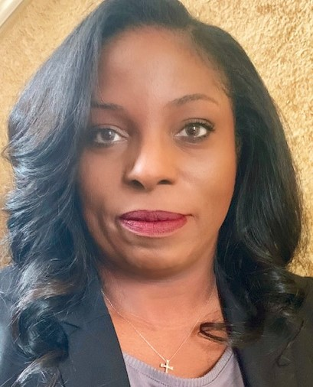
MCLEAN & COMPANY
Courageous Discussions on Racial Equity in the Workplace
Who we are
Lori Bishop is a 20-year HR champion with industry backgrounds that include healthcare, technology, market research, consumer goods and products and manufacturing.
She has recently collaborated with Drew Clancy, CEO of Publishing Concepts, Inc. to create an intervention in support of social justice and anti-racism initiatives.
Her organization’s True Trust – Meaningful Conversations series has created an internal dialogue with employees to learn the history of structural racism and discrimination in the US as a foundation to find ways to build trust within their organization.
Lori Bishop
Chief People Officer, Publishing Concepts
4

Slide 5
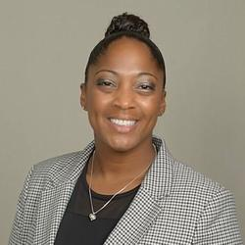
Courageous Discussions on Racial Equity in the Workplace
Who we are
Cinnamon is a Director of Diversity, Equity & Inclusion (DEI) Services at McLean & Company, where she leads the development and delivery of client-facing services.
Her strategic approach has led to success in the DEI space in the private sector as well as the government sector, most notably in the United States Navy’s Special Operations Forces.
Cinnamon holds a Master of Arts in Human Behavior/Organizational Leadership from National University and a Bachelor of Arts in Social Science from Chapman University
Cinnamon Clark
Director of Diversity, Equity & Inclusion (DEI), McLean & Company

Slide 6
Courageous Discussions on Racial Equity in the Workplace
Webinar Objectives
Discuss Lori Bishop’s experience as an HR professional. We will be highlighting her leadership and trusted advisor role in her organization.
01
Hear from Lori on her organization’s journey towards being a diverse and inclusive environment. What were their challenges? Successes? Where are they now?
02
Understand that the hard conversations must be had, and how open communication, even when it is not easy is beneficial to your organizational effectiveness.
03

Slide 7
Courageous Discussions on Racial Equity in the Workplace
Lori’s experience
Discussion

Slide 8
Courageous Discussions on Racial Equity in the Workplace
Lori’s organization’s journey toward diversity, inclusion, and racial equity
Discussion

Slide 9
Courageous Discussions on Racial Equity in the Workplace
Courageous conversations
Discussion

Slide 10
MCLEAN & COMPANY
Courageous Discussions on Racial Equity in the Workplace
Time for a few questions…
Q&A

Slide 11
MCLEAN & COMPANY
Courageous Discussions on Racial Equity in the Workplace
Supporting Resources
Spotlight: Being an Organizational Ally: Moving Beyond the Social Media Post
LMS Download: Foundations of Diversity, Equity, and Inclusion
Biases and Heuristics Catalog
Training Deck: Equip Managers to Adopt Inclusive Leadership Behaviors
Nudges: A Paradigm for HR to Influence Employee Behavior
And more on our website: hr.mcleanco.com
McLean & Company’s COVID-19 Resource Center
McLean & Company’s Online Workshop: Diversity, Equity, and Inclusion Strategy
11

Slide 12
Thank you!
For information on McLean & Company’s products and services, please contact:
​
Jon Campbell
jcampbell@mcleanco.com

