Slide 1
Ensure Your Pandemic Response Plan Is Privacy-Proof
Don’t panic – prepare today’s pandemic response plan to accommodate tomorrow’s privacy implications.
Sample
Get the complete storyboard with free trial membership now!

Slide 2
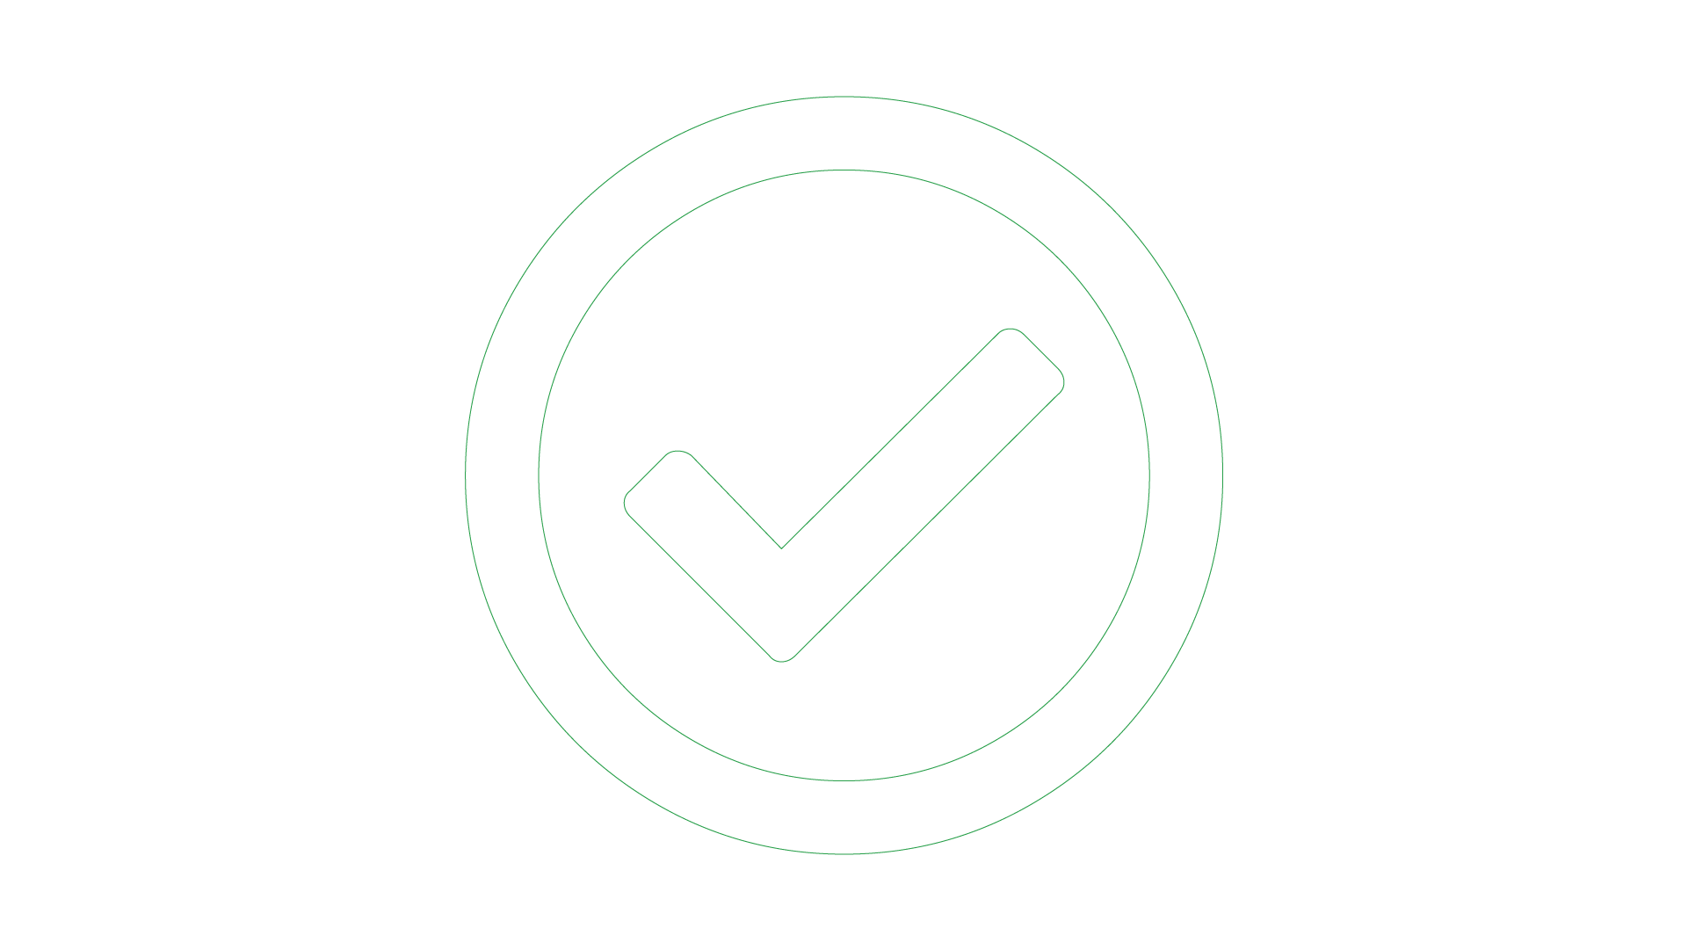
Executive Summary
Challenge
Obstacles
Info-Tech’s Approach
COVID-19 has thrown organizations globally into a panicked frenzy as they attempt to adopt and scale operations to align with government recommendations and keep employees safe.
Enforced data privacy best practices may contradict procedures that are implemented in the best interest of employees’ safety.
Processes adapted as a part of crisis response and management may not always align with privacy regulations and laws (GDPR, CCPA, HIPAA).
Some of the personal data being collected wouldn’t normally be as a part of your organization’s business processes, which may harm the business in the long term.
At what point does collection of personal data become necessary with respect to impact on the health and safety of your organization?
How can the process for handling personal data as a part of an incident-specific procedure be optimally managed?
Don’t start from scratch. Leverage your current data privacy best practices and adapt them to align with your pandemic-ready operational changes.
Collect what you need, disregard what you don’t. Reduce the amount of unnecessary personal data collected.
Enforce procedures to support your employees’ integration of these best practices. They will serve you well not only in a pandemic but also further down the data privacy path.
Info-Tech Insight
An effective pandemic plan will be privacy-proof in order to support the future strategic direction of the organization. Don’t throw your privacy best practices out the window; be adaptable and create a repeatable process that is well-documented and well-circulated.

