Slide 1
MODERNIZE THE PERFORMANCE APPRAISAL
Bring performance management out of the dark ages to improve employee performance and engagement, and reduce costs for the business.
SAMPLE
Learn about becoming a member
McLean & Company is a research and advisory firm providing practical solutions to human resources challenges via executable research, tools and advice that have a clear and measurable impact on your business. © 1997-2017 McLean & Company. McLean & Company is a division of Info-Tech Research Group.

Slide 2
EXECUTIVE SUMMARY
Walk away from this blueprint with:
Situation
We have known for over 50 years that the traditional performance appraisal (PA) doesn’t work, yet we keep using it.
Today’s business world is fast paced and your performance appraisal process needs to be flexible so goals can be adaptable to change.
Employees crave real-time feedback and coaching, which isn’t happening with the traditional performance appraisal.
The knowledge that only 56% of employees agree that their managers provide them with high quality feedback, meaning that only half receive effective feedback or guidance to help drive performance. Managers need the tools and practice through training to reach the other half with helpful, directive feedback (McLean & Company Engagement Survey, 2016; N=65,282).
The understanding that managers need the tools and practice to become more effective in giving feedback. Employees drive the modern PA to free up the manager’s time so they can focus on feedback and coaching.
Complication
Designing a new performance appraisal can be a difficult and lengthy process.
Most HR departments are too busy to develop the new process, tools, and training that are needed for a new performance appraisal process.
Resolution
A modern performance appraisal that:
Incorporates clearly defined expectation setting between managers and employees with the use of competencies.
Requires employees to set goals with their managers to cover work-related goals, as well as development objectives.
Uses feedback and coaching at every touchpoint to support employee performance and productivity.
Supports more frequent manager assessments, as well as employee self-assessments to level set performance.
Reduces administration on the managers and places it in the hands of employees to empower themselves.
SAMPLE

Slide 3
MCLEAN & COMPANY OFFERS VARIOUS LEVELS OF SUPPORT TO BEST SUIT YOUR NEEDS
DIY
TOOLKIT
GUIDED IMPLEMENTATION
WORKSHOP
CONSULTING
“Our team has already made this critical project a priority, and we have the time and capability, but some guidance along the way would be helpful.”
“Our team knows that we need to fix a process, but we need assistance to determine where to focus. Some check-ins along the way would help keep us on track.”
“We need to hit the ground running and get this project kicked off immediately. Our team has the ability to take this over once we get a framework and strategy in place.”
“Our team does not have the time or the knowledge to take this project on. We need assistance through the entirety of this project.”
Diagnostics and consistent frameworks used throughout all four options
SAMPLE

Slide 4
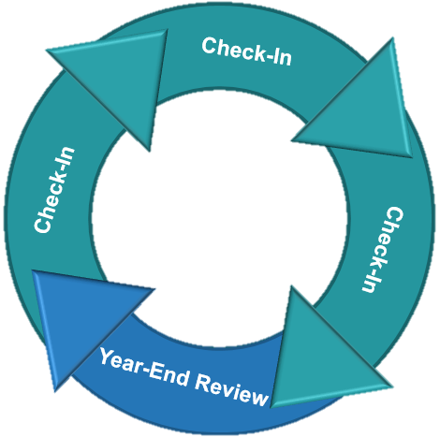
Use McLean & Company’s five-step process to modernize your performance appraisal and engage your employees
Follow Up and Measure Success
Track updated results after modernizing the PA.
Communicate and Train to Manage Change
Manage the change process of an updated PA with a solid communication strategy and training.
Put the Framework in Action
Review how the framework will work in action.
Design Your Modern PA Framework
Customize key requirements.
Understand the Modern PA Framework
Learn the McLean & Company modern PA framework.
SAMPLE

Slide 5
SAMPLE SLIDES
SAMPLE

Slide 6
It’s time to modernize the traditional PA to be a more effective and collaborative assessment
We’ve known for more than 50 years that the traditional performance appraisal doesn’t work – yet we keep using it!
In 1965, the Harvard Business Review reported the results of a landmark study that tested the effectiveness of traditional performance appraisal systems at General Electric and found them ineffective (Smith and Rutigliano).
Traditional performance appraisals are ineffective because:
They are not adaptable for today’s world of work.
The system was developed for a static, unchanging environment.
This is not how the business world of today works.
They are a poor driver of performance.
Feedback given to an employee is backward looking.
Does not easily help employees understand how to change or improve performance on an ongoing basis.
They are a huge de-motivator.
Biased ratings and lack of direction create high levels of employee discontent, which can lead to:
Disengagement
Turnover
“
The reality is that the traditional performance appraisal as practiced in the majority of organizations today is fundamentally flawed and incongruent with our values-based, vision-driven, and collaborative work environments. - Ray Williams
”
SAMPLE

Slide 7
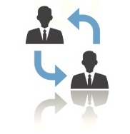
The modern PA framework has more regular expectation and goal setting, feedback and coaching, and assessment
At every performance appraisal touchpoint (quarterly check-ins and the year-end review), managers and employees should:
A study done by the Institute for Corporate Productivity reported that these performance management activities had a moderate to high correlation with business success. When there is an increase in the use of these initiatives, there is a moderate to high increase in business success.
Set Expectations: What employees are expected to do and how they should do it.
Use competencies: What behaviors and actions employees should embody at work.
Define Goals: What business and development goals need to be set and achieved to impact the work they do in their role and the organization, and their learning.
Performance management activities | Correlation with business success
Ongoing goal review and feedback | 0.64
Developmental plans for next period | 0.60
Goal setting for upcoming time frame | 0.57
Review of relevant accomplishments | 0.54
Provide Feedback and Coaching: What employees have done in the past that demonstrated desired behavior or what they can do to correct undesired actions. What advice managers can give to employees to affect future behavior.
Assess Performance: Together, managers and employees assess performance against goals, expectations, and competencies for the period. At the year-end, HR and managers get together to calibrate performance ratings.
(Stalinski and Downey, 2012)
SAMPLE

Slide 8
Use McLean & Company’s performance rating scale during check-ins and the year-end review
2
5 Exceptional | Your performance is consistently superior to the expectations and standards required for the position. Your job performance results in extraordinary and exceptional accomplishments with significant contributions to the goals of the department and organization.
4 Exceeds | You routinely exceed expectations and there are no areas in which you are not entirely proficient. Your job performance is significantly better than that of your peers. The high quality of your work, both in the results you achieve and how you achieve them, is an example to your colleagues.
3 Delivers | You are consistently delivering on expectations and are fully capable in all aspects of your role. There may be some areas in which your job performance exceeds the role's performance expectations. Both the results you achieve and the way in which you go about performing your job are good examples to others.
2 Developing | You are delivering on some expectations of the job, but not all. There are some performance gaps that have been identified and require improvement.
1 Did Not Deliver | Your performance does not meet the minimum expectations for this job and is not acceptable. There are performance gaps that have been identified and require immediate action.
McLean & Company insight
Employees who agreed or strongly agreed with the statement “My manager helps me achieve better results” were more likely to agree with the statement “I regularly accomplish more than what’s expected in my role.” Manager involvement drives business results; by paying closer attention and assessing their employees more precisely, managers can motivate employees to increase their performance (McLean & Company Engagement Survey, 2016; N=54,538).
SAMPLE

Slide 9
MCLEAN & COMPANY HELPS HR PROFESSIONALS TO:
“
✓
Empower management to apply HR best practices
Maintain a progressive set of
HR policies & procedures
✓
Now, more than ever,
HR leaders need to help their organizations maximize the value of their people.
McLean & Company offers the tools, diagnostics, and programs to drive measurable results.
– Jennifer Rozon,
Vice President,
McLean & Company
✓
Develop effective talent acquisition & retention strategies
Demonstrate the business impact of HR
✓
“
✓
✓
Build a high performance culture
Stay abreast of HR trends & technologies
Sign up to have access to our extensive selection of practical solutions for your HR challenges
LEARN ABOUT BECOMING A MEMBER
Toll Free: 1-877-281-0480
hr.mcleanco.com
SAMPLE

