Slide 1
Strategically Develop a 360 Feedback Process
Maximize 360 Feedback effectiveness through purposeful planning and implementation.

Slide 2

Strategically Develop a 360 Feedback Process
McLean & Company is a research and advisory firm providing practical solutions to human resources challenges via executable research, tools, and advice that have a clear and measurable impact on your business.
Our research team uses a rigorous research process to identify and hone best practices; create practical tools, templates, and policies; and supply clients with the insight and guidance of our subject matter experts. McLean & Company applies this proven research approach to both human resources and company management teams, creating complete solutions that supply the tools you need to get each project done right.
McLean & Company analysts bring real-world experience to the table and apply their knowledge to solving the challenges faced by our clients on a daily basis. This process is informed by the participation of a client base that includes over 30,000 members and by an evolving client-driven research agenda.
McLean & Company is a division of Info-Tech Research Group Inc.

Slide 3


Strategically Develop a 360 Feedback Process
Who we are
Ashley Michael
Director, Learning Solutions
James Kim
Consulting Analyst, HR Research & Advisory Services

Slide 4
Strategically Develop a 360 Feedback Process
Webinar Objectives
01
Introduce 360 Feedback assessment, best use, and complications
02
Review the 360 process strategic roadmap
03
Understand how to use feedback effectively
McLean & Company | 4

Slide 5



What is a 360 Feedback process?
Strategically Develop a 360 Feedback Process
360 Feedback assessment
Aggregates multiple raters’ observations of an employee’s proficiency in specific competencies to provide feedback to the employee and contribute to their individual development plans.
360 Feedback often has the following elements:
Purpose
Participants
Competencies

Slide 6





360 Feedback recommended use and benefits
Strategically Develop a 360 Feedback Process
McLean & Company recommends using 360 Feedback exclusively for employee development.
360s help employees create a development plan that:
360s used for development improve:
Improves
self-awareness
Minimizes bias
Targets key behaviors
Retention
Engagement

Slide 7




Common obstacles of the 360 Feedback process include…
Strategically Develop a 360 Feedback Process
No tool to gather feedback
Lack of employee buy-in
Lack of feedback skills
No follow through

Slide 8

360 Feedback process requires a planful approach supported by a strategic roadmap
Strategically Develop a 360 Feedback Process
1
2
3
4
5
6
7
Lay Foundational Elements
Scope Processes
Design Assessment
Communicate and Train
Launch Assessment
Debrief and Plan for Development
Iterate Process

Slide 9


Before you dive in, do you have the foundational elements in place?
Strategically Develop a 360 Feedback Process
Culture of Trust
Competencies
Feedback Maturity

Slide 10

Be clear about how the 360 Feedback will contribute to development

Slide 11







Scope the 360 process and design the assessment
Strategically Develop a 360 Feedback Process
Determine target population and criteria for participation
Select competencies that will be used to collect feedback to achieve the purpose
Determine the cadence and frequency of the assessment
Outline the rater selection and approval process
Scope roles and accountabilities
Select goals and metrics linked to the purpose

Slide 12



Strategically Develop a 360 Feedback Process
Communication is key for a successful 360 process!
Purpose
“What’s in it for me”
Confidentiality
Key Principles to Communicate

Slide 13
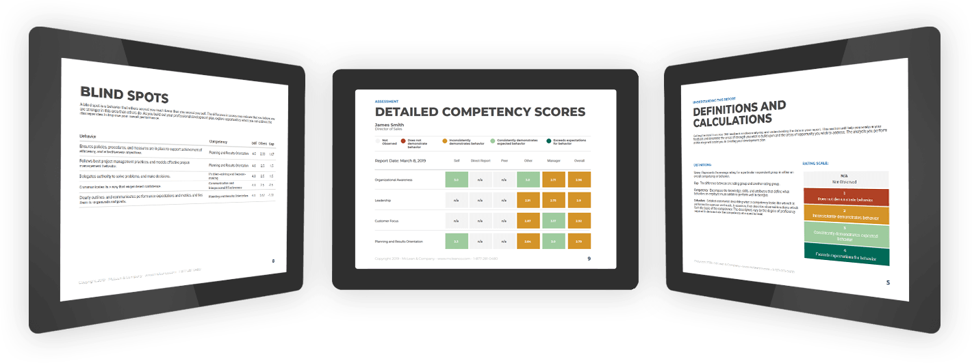

Launch the assessment with McLean & Company’s easy-to-use 360 Feedback Assessment
All McLean & Company members have access to this customizable solution to rate the essential competencies required to achieve organizational goals and remain competitive.

Slide 14


Interpret and use feedback effectively to see the full value of 360s
Strategically Develop a 360 Feedback Process
Debrief and Plan for Development
Prepare to conduct results debriefing
Facilitate the interpretation of feedback and creation of a development plan

Slide 15



Strategically Develop a 360 Feedback Process
Coach leaders to improve self-awareness, clarity, and confidence
Maximize leaders’ performance with McLean & Company’s Leadership Development Coaching offering
Coaching enables leaders to realize their development plans and holds them accountable.
1:1 discussions to ensure assessment understanding and further self-awareness
Coaching sessions are at ideal times to increase reflection and learning
Exercises bolster the experience and encourage ownership of development

Slide 16
Strategically Develop a 360 Feedback Process
Key Takeaways
1
Use the 360 Feedback exclusively for employee development​
01
2
02
Take a very planful approach
3
03
Clear and consistent communication is key
4
04
Leaders are responsible for their own development

Slide 17
Strategically Develop a 360 Feedback Process
Additional Resources
Neuro-Friendly HR Practices
Neuroscience and HR
Biases and Heuristics Catalog
360 Feedback Foundational Elements
Develop a Comprehensive Competency Framework
Foster Effective Feedback Skills
Equip Managers to Lead Through Informed Trust and Accountability
360 Feedback Scope and Assessment Design
360 Feedback Assessment User Guide
360 Feedback Debrief Guide
Interpretation and Use of Feedback
360 Feedback Interpretation and Development Plan Job Aid
Train Managers to Coach Employees for High Performance and Development

Slide 18

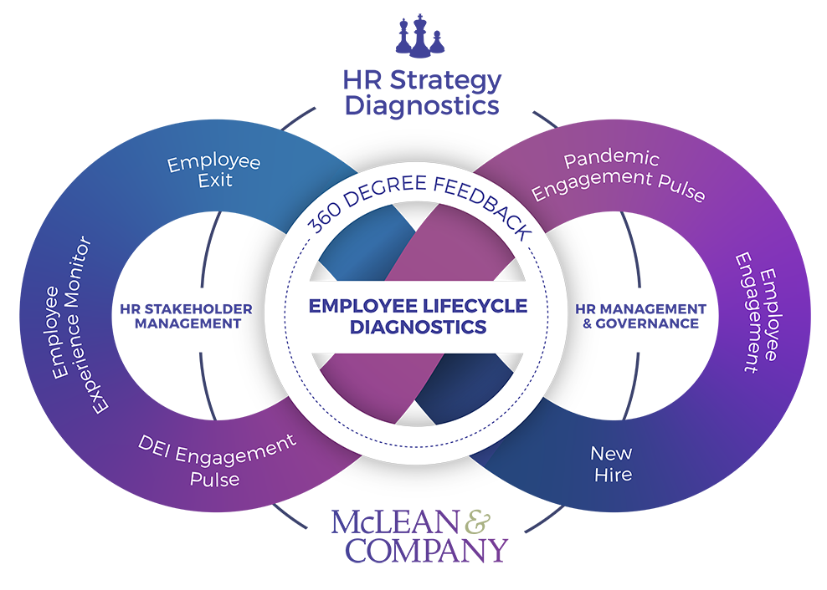

Full-Service Diagnostic Programs
Improve Employee Experience and HR Processes
Create evidence-based plans to address pandemic churn using our...
New Hire Survey
Ensure recruiting and onboarding programs are effective by surveying new employees.
Employee Engagement
Move beyond measuring job satisfaction with a comprehensive view of engagement.
Pandemic Engagement Pulse Check
Assess the effect of pandemic response plans on employee engagement.
Diversity, Equity, and Inclusion Engagement Pulse
Take a thoughtful approach to mobilize inclusion efforts across your organization.
McLean Employee Experience Monitor
Evolve to leader-driven engagement with a real-time dashboard and results.
Employee Exit Survey
Understand why people leave the organization to proactively retain top talent.
360 Feedback Assessment
Empower employees with a holistic view of their performance to prioritize development.
Optimize the HR Department for Success
HR Stakeholder Management Survey
Align HR initiatives with business strategy and stakeholder needs.
HR Management & Governance
Improve HR’s core functions and drive project success.

Slide 19
Strategically Develop a 360 Feedback Process
Time for a few questions…
Q&A

Slide 20


McLean & Company is a research and advisory firm providing practical solutions to human resources challenges via executable research, tools, and advice that have a clear and measurable impact on your business.
Our research team uses a rigorous research process to identify and hone best practices; create practical tools, templates, and policies; and supply clients with the insight and guidance of our subject matter experts. McLean & Company applies this proven research approach to both human resources and company management teams, creating complete solutions that supply the tools you need to get each project done right.
McLean & Company analysts bring real-world experience to the table and apply their knowledge to solving the challenges faced by our clients on a daily basis. This process is informed by the participation of a client base that includes over 30,000 members and by an evolving client-driven research agenda.
McLean & Company is a division of Info-Tech Research Group Inc.
Contact Us
 | Phone: North America: 1-877-281-0480 International: +1-519-936-2659 Website: mcleanco.com
London, Ontario, Canada Corporate headquarters 345 Ridout Street North London, Ontario N6A 2N8
Toronto, Ontario, Canada
888 Yonge Street
Toronto, Ontario M4W 2J2

Slide 21
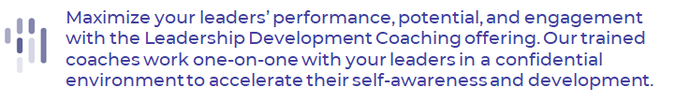
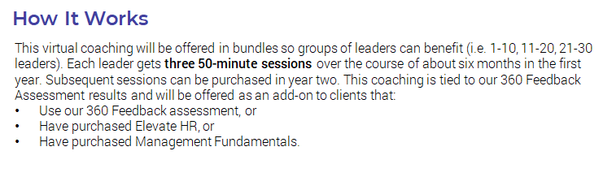
Leadership Development Coaching

Slide 22
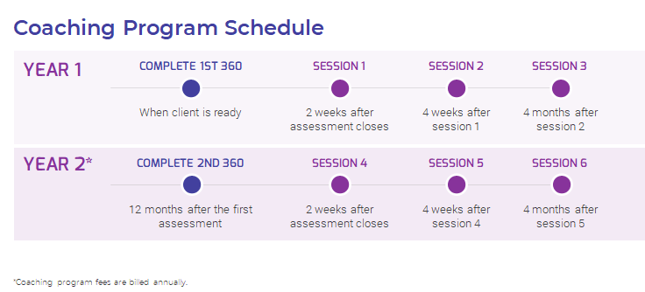
Leadership Development Coaching Ct'd

Slide 23


Thank you!
For information on McLean & Company’s products and services, please contact:
Jon Campbell
jcampbell@mcleanco.com

