Slide 1
Transform the 9-Box Talent Assessment
Take the 9-box from a yearly tick-box exercise to a dynamic assessment that reveals hidden talent and boosts performance from every employee.
SAMPLE
Learn about becoming a member
McLean & Company is a research and advisory firm providing practical solutions to human resources challenges via executable research, tools and advice that have a clear and measurable impact on your business. © 1997-2016 McLean & Company. McLean & Company is a division of Info-Tech Research Group.
Notes:
There are facilitator’s notes in this storyboard.

Slide 2
EXECUTIVE SUMMARY
Walk away from this blueprint with:
Situation
Talent assessment is the starting point for successfully developing and managing organizational talent at all levels.
The 9-box talent grid is the gold standard for assessment, and when used appropriately, provides consistent and objective standards with which to fairly assess employees.
A clear and consistent set of criteria for assessing employees.
An overview of where talent lies in your organization by using the 9-Box Talent Grid Assessment Tool.
A training deck for managers that guides them through using the 9-box for assessment.
Complication
When used inappropriately, the 9-box can become a tick-box exercise that hinders employee development.
The 9-box loses its efficacy when the assessments used to fill out the grid are inaccurate, when biases are not corrected, when managers use different standards for assessment, and when the 9-box is not translated into development opportunities that connect to organizational goals.
Solution
Transform the 9-box into a strategic tool by:
Improving the quality of assessments that go into plotting employees on the grid.
Making group calibration a regular priority.
Creating development plans that bring out the best in every employee.

Slide 3
MCLEAN & COMPANY OFFERS VARIOUS LEVELS OF SUPPORT TO BEST SUIT YOUR NEEDS
DIY
TOOLKIT
GUIDED IMPLEMENTATION
WORKSHOP
CONSULTING
“Our team has already made this critical project a priority, and we have the time and capability, but some guidance along the way would be helpful.”
“Our team knows that we need to fix a process, but we need assistance to determine where to focus. Some check-ins along the way would help keep us on track.”
“We need to hit the ground running and get this project kicked off immediately. Our team has the ability to take this over once we get a framework and strategy in place.”
“Our team does not have the time or the knowledge to take this project on. We need assistance through the entirety of this project.”
Diagnostics and consistent frameworks used throughout all four options

Slide 4
Use McLean’s 5-Step Talent Assessment Process
1. Identify Talent Needs and Priorities
2. Customize and Enhance the 9-Box
3. Assess Talent, Calibrate, and Continue Talent Conversations
4. Develop Talent Using Assessment Results
5. Integrate and Measure Assessment
Replace image at this size

Slide 5
SAMPLE SLIDES

Slide 6
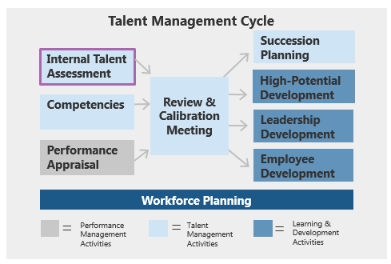
Effective talent assessment increases engagement and retention
Talent assessment is the starting point for successfully developing and managing organizational talent at all levels, not just for identifying high-potential employees.
You can’t develop or strategically place talent if you don’t know their current abilities.
However, in the 2016 HR Trends & Priorities Survey, 75% of respondents rated their “Internal Talent Assessment” as ineffective (McLean & Company, 2016, N=555).
Talent assessment leads to development opportunities that help to retain and engage employees:
A study of more than 3,900 U.S. employees by CareerBuilder found that 35% of workers agree that increasing on-the-job training and development opportunities entices them to stay with a company (Pollak, 2015).
30% of employees cited a lack of opportunities for career-related skill development and 37% cited lack of opportunities for career advancement as primary reasons for leaving their jobs (McLean & Company Employee Exit Survey, 2016, N=3,325).
When good employees leave the organization for better development elsewhere, it can cost 1.5x the amount, or more, of departing employee’s salary (Boudreau, 2014).
89% of respondents who strongly agreed with the statement “I am given the chance to fully leverage my talents through my job” were also engaged (McLean & Company, 2016, N=13,009).

Slide 7
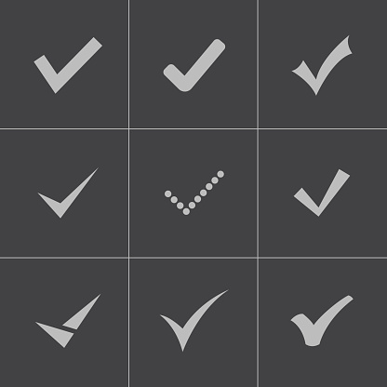
Used inappropriately, the 9-box can be a tick-box exercise that hinders employee development
The 9-box becomes largely useless when assessments are:
Infrequent and not documented carefully, which makes them overly reliant on the manager’s memory.
Inconsistent due to the difficulty of defining criteria such as potential, which means managers may be using different standards within the same organization (Brook).
Biased because managers may favor people like themselves, assess minorities more harshly, and wrongly base future assessments off of a first impression, whether good or bad (Kosinski, Gutierrez y Muhs, Cherry, Snee).
Highly politicized, so that those with the “right” manager may be assessed more favorably and given more development opportunities than those who are less well connected within the organization.
Inaccurate 9-box placement can limit employee development:
Once the 9-box grid is populated, there is a tendency for management and senior leadership to treat it as “set in stone”:
If the initial assessments are not fair/accurate, there is little likelihood that they will be updated or corrected, which may lead to fewer opportunities for employees to grow and develop.
Danger of employees being “written off” and not given adequate development and job opportunities as a result (see case study on next slide).
Increased risk of losing good employees who have moved from one box to another, but do not get any further chances to prove themselves.

Slide 8
Each combination of potential and performance represents a subgroup & talent profile in the grid
Potential
Performance
The talent development support that an employee receives is based on their profile.
Subgroups
Individual Talent Profile
Top Talent
These employees are the high achievers of the organization.
Potential
Low Performance/
High Potential
Medium Performance/
High Potential
High Performance/
High Potential
High
Core Talent
These employees are the solid working base of the company.
Low Performance/
Medium Potential
Medium Performance/
Medium Potential
High Performance/
Medium Potential
Performance
Underachievers
These employees may need a second look, and may be managed up or out.
Low Performance/
Low Potential
Medium Performance/
Low Potential
High Performance/ Low Potential
Low
See Tabs 2a and 3 in the 9-Box Talent Grid Assessment Tool for more information on each box.
Low
High

Slide 9
MCLEAN & COMPANY HELPS HR PROFESSIONALS TO:
“
✓
✓
Now, more than ever, HR leaders need to help their organizations maximize the value of their people.
McLean & Company offers the tools, diagnostics, and programs to drive measurable results.
– Jennifer Rozon, Vice President, McLean & Company
Empower management to apply HR best practices
Maintain a progressive set of
HR policies & procedures
✓
Develop effective talent acquisition & retention strategies
Demonstrate the business impact of HR
✓
“
✓
✓
Build a high performance culture
Stay abreast of HR trends & technologies
Sign up to have access to our extensive selection of practical solutions for your HR challenges
LEARN ABOUT BECOMING A MEMBER
Toll Free: 1-877-281-0480
hr.mcleanco.com
SAMPLE

