Slide 1
Develop an Integrated People Strategy
An integrated people strategy not only supports but drives organizational goals, maximizing the human capital contribution to the bottom line.
SAMPLE
Learn about becoming a member
McLean & Company is a research and advisory firm providing practical solutions to human resources challenges via executable research, tools and advice that have a clear and measurable impact on your business. © 1997-2016 McLean & Company. McLean & Company is a division of Info-Tech Research Group.

Slide 2
EXECUTIVE SUMMARY
Situation
Increased demands and expectations of HR departments act as barriers for HR to move beyond tactical HR operations and add strategic value to the organization.
HR has valuable strategic people insights that can inform and shape a more robust organizational strategy.
Walk away from this blueprint with:
A robust organizational strategy which not only considers, but adjusts for and incorporates relevant people implications.
The ability to develop a people strategy that is effectively integrated with the broader organizational strategy, empowering HR with more influence as a strategic organizational partner.
An integrated people strategy that not only supports but drives organizational goals to create and sustain a competitive human capital advantage.
Complication
Designing and implementing an integrated people strategy is a sizeable commitment requiring thoughtful attention and time.
Truly understanding organizational goals, challenges, and opportunities requires having a different skill set and approach than HR may be accustomed to.
Organizational cadence and goals are constantly changing and evolving requiring strategies to be flexible and adaptable to a number of possibilities.
Resolution
HR needs to fully immerse within the organization to truly understand how and where it competes, and to identify any challenges and opportunities.
HR must prioritize its efforts and resources aggressively to deliver the most impactful initiatives.
People strategies need to be flexible and adaptable to the ever-evolving world we live in. People strategies should not be static and need to be revisited frequently and modified accordingly.
SAMPLE

Slide 3
MCLEAN & COMPANY OFFERS VARIOUS LEVELS OF SUPPORT TO BEST SUIT YOUR NEEDS
DIY
TOOLKIT
GUIDED IMPLEMENTATION
WORKSHOP
CONSULTING
“Our team has already made this critical project a priority, and we have the time and capability, but some guidance along the way would be helpful.”
“Our team knows that we need to fix a process, but we need assistance to determine where to focus. Some check-ins along the way would help keep us on track.”
“We need to hit the ground running and get this project kicked off immediately. Our team has the ability to take this over once we get a framework and strategy in place.”
“Our team does not have the time or the knowledge to take this project on. We need assistance through the entirety of this project.”
Diagnostics and consistent frameworks used throughout all four options
SAMPLE

Slide 4
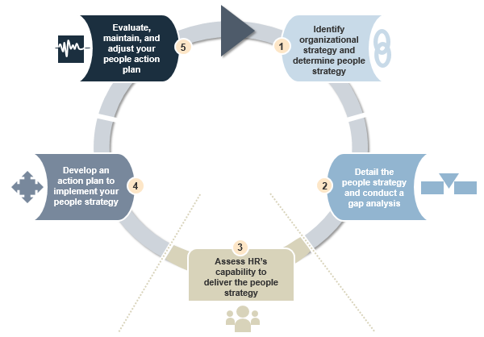
Use McLean & Company’s process to effectively develop an integrated people strategy
Evaluate, maintain and adjust your strategic people plan
SAMPLE

Slide 5
SAMPLE SLIDES
SAMPLE

Slide 6
Misaligned people strategies and organization goals can lead to a perception of ineffectiveness
Close the gap in effectiveness by integrating HR’s focus with organizational needs.
HR/People strategy is aligned to organizational goals
HR/People strategy is effective
Organizations must carefully evaluate where to focus on being strategic, and where to be tactical or operational.
Agree
Strategy is critical with processes moving from HR-owned to HR-facilitated.
Disagree
Agree
Neutral
Disagree
Examples include:
Leader-driven engagement
Performance coaching vs. annual appraisals
(McLean & Company, HR Stakeholder Management Survey; 2016; N=1224 )
(McLean & Company, 2016 Trends & Priorities, N=525 )
A significant proportion of respondents believe that their heads of HR are overly preoccupied with a narrow HR agenda.
HR Heads…
Any misalignment between HR and its stakeholders will reduce effectiveness across all functions. Start closing the gap by confirming where these gaps exist.
Are too Focused on Processes and Rules
41%
Don’t Understand the Business Well Enough
37%
(McLean & Company, 2016 Trends & Priorities)
(Holley, 2014)
0
100
SAMPLE

Slide 7
People strategy creates a competitive human capital advantage and drives success
A number of HR strategy activities are related to organizational performance. The strongest relationship is [having] a human capital strategy that is integrated with the business strategy.
– Lawler and Boudreau
A unique competitive advantage
“
People strategy should work in conjunction with your organizational strategy to provide a competitive human capital advantage.
A carefully considered people strategy that propels organizational culture is much more difficult for competitors to replicate than process or product features. (Mapesa)
”
Examples of competitive people advantages that drive organizational performance results include:
Highly innovative corporate culture
Attractive Employee Value Proposition (EVP)
Strong customer service ratings
Increased organizational success
Organizations that align talent management to strategy:
Have more successful projects.
Waste fewer project dollars. (PMI, 2014)
“
The old bastions of competitive advantage are in most cases no longer relevant […] the only truly sustainable competitive advantage left is the creation of a corporate culture that is built on a foundation of continuous innovation and extreme customer focus ― both of which can be delivered only by highly talented people.
– John Spence
High-performing organizations are 2x more likely to align talent management to organizational strategy compared to low-performing counterparts. (PMI, 2014)
”
High-performing organizations place more importance on people strategy than low-performing organizations. (WFPMA)
SAMPLE

Slide 8
MCLEAN & COMPANY HELPS HR PROFESSIONALS TO:
“
✓
Empower management to apply HR best practices
Maintain a progressive set of
HR policies & procedures
✓
Now, more than ever,
HR leaders need to help their organizations maximize the value of their people.
McLean & Company offers the tools, diagnostics, and programs to drive measurable results.
– Jennifer Rozon,
Vice President,
McLean & Company
✓
Develop effective talent acquisition & retention strategies
Demonstrate the business impact of HR
✓
“
✓
✓
Build a high performance culture
Stay abreast of HR trends & technologies
Sign up to have access to our extensive selection of practical solutions for your HR challenges
LEARN ABOUT BECOMING A MEMBER
Toll Free: 1-877-281-0480
hr.mcleanco.com
SAMPLE

