Slide 1
Don’t Just Engage, Lead
Transition to integrated leadership empowerment to drive business results.
SAMPLE
Learn about becoming a member
McLean & Company is a research and advisory firm providing practical solutions to human resources challenges via executable research, tools and advice that have a clear and measurable impact on your business. © 1997 - 2016 McLean & Company. McLean & Company is a division of Info-Tech Research Group

Slide 2
EXECUTIVE SUMMARY
Walk away from this blueprint with:
Situation
Current engagement efforts fail to make the connection between employee engagement and business results, requiring a shift in engagement purpose, cadence, and focus.
CEOs are least satisfied with employee engagement when compared to 31 other HR core services (McLean & Company Stakeholder Management Survey, 2015).
The knowledge that employee engagement is about how managers lead through engaging leadership behaviors. Leaders who are invested in their people experience improved results.
The understanding that engagement is a reflection of effective management practices. Leaders’ recommitment to their role as people managers will in turn positively impact their role as business leaders.
Complication
Current efforts are only shifting engagement incrementally.
Aggregate year-over-year engagement scores have become the focus.
Static, annual engagement measures do not capture fluctuations in engagement that should prompt leaders to integrate engagement into day-to-day management practice.
Resolution
Shift engagement from a discrete activity based on an annual survey to one that is more integrated with the day-to-day tasks of the workplace.
Empower leaders to understand and own their impact on engagement through effective day-to-day management practices and behaviors.
Shift organizational thinking about engagement from an HR-owned program to one that is leader-driven through engaging behaviors.
SAMPLE

Slide 3
MCLEAN & COMPANY OFFERS VARIOUS LEVELS OF SUPPORT TO BEST SUIT YOUR NEEDS
DIY
TOOLKIT
GUIDED IMPLEMENTATION
WORKSHOP
CONSULTING
“Our team has already made this critical project a priority, and we have the time and capability, but some guidance along the way would be helpful.”
“Our team knows that we need to fix a process, but we need assistance to determine where to focus. Some check-ins along the way would help keep us on track.”
“We need to hit the ground running and get this project kicked off immediately. Our team has the ability to take this over once we get a framework and strategy in place.”
“Our team does not have the time or the knowledge to take this project on. We need assistance through the entirety of this project.”
Diagnostics and consistent frameworks used throughout all four options
SAMPLE

Slide 4
Follow McLean & Company’s 4-step process to support integrated leadership empowerment
Sustainable execution on organizational strategy to deliver on business results can only be optimized through integrated leadership empowerment. Leaders who demonstrate they are invested in their people drive investment by their people.
Organizational Strategy
Leader-Driven Employee Engagement
Business Results
Step 4
Step 1
Prepare to launch
Introduce a more dynamic engagement measurement
Integrated Leadership Empowerment
Step 2
Step 3
Make the connection between engagement and business results
Reinforce leaders’ role in the new engagement paradigm
Follow these process steps to reinforce leader-driven employee engagement in your organization.
SAMPLE

Slide 5
SAMPLE SLIDES
SAMPLE

Slide 6
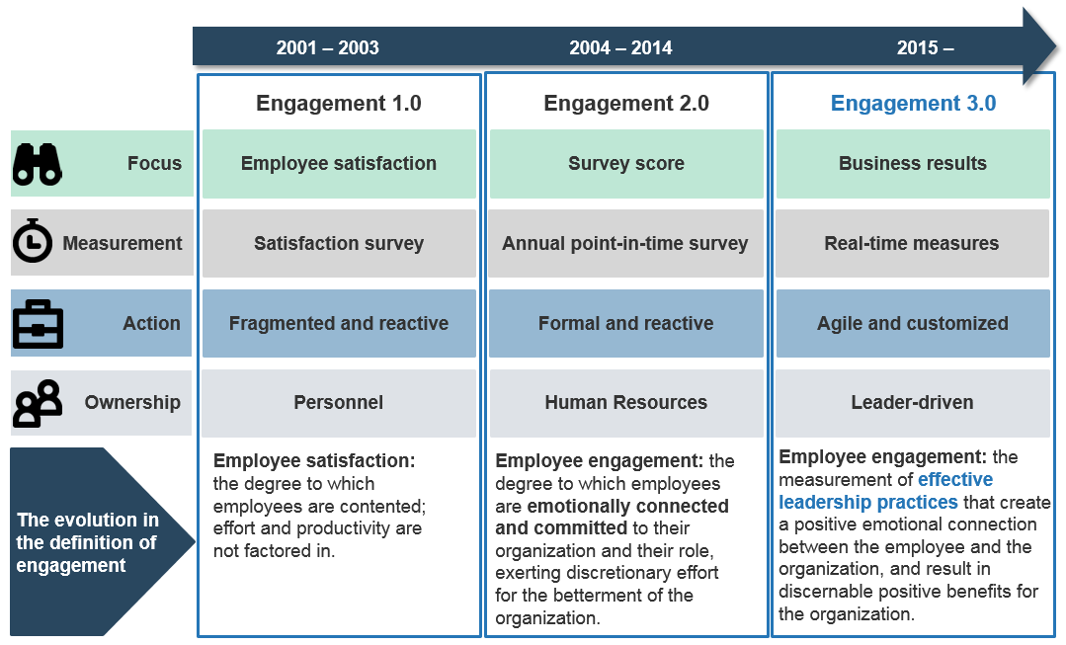
The new engagement paradigm: transition to leader-driven engagement
Employee engagement is not a program. It is how managers lead through engaging leadership behaviors.
Engagement must be a way of life for leaders, not an add-on.
For more information on Engagement 3.0, see McLean & Company’s blueprint, Engagement 3.0: Transitioning to Leader-Driven Engagement.
SAMPLE

Slide 7
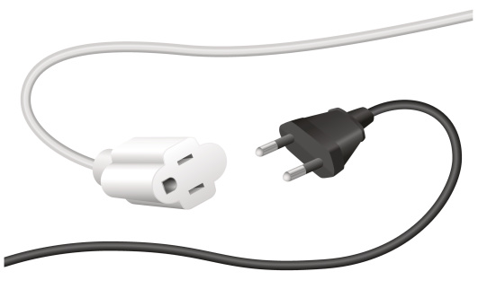
Organizations struggle to connect engagement with business results
For the most part, engagement efforts have been focused on attraction, retention, and the associated business impact. To truly make the connection to business results, pay attention throughout the employee life cycle. Continued focus is required to engage employees in a way that has a measurable and positive impact on business results.
Of the 31 core HR services, CEOs are least satisfied with employee engagement (McLean & Company Stakeholder Management Survey, 2015, N=330).
Only 36% of respondents rate their employee engagement efforts as effective (McLean & Company 2016 HR Trends & Priorities Survey, 2015, N=525).
Less than 50% of companies said that they are effectively measuring employee engagement against business performance metrics such as customer satisfaction or increased market share (HBR, 2013).
“
Business leaders are finding the intermediate goals of retention and discretionary effort insufficient ambitions.
– Scott Bohannon, CEO, Info-Tech Research Group
”
SAMPLE

Slide 8
MCLEAN & COMPANY HELPS HR PROFESSIONALS TO:
“
✓
Empower management to apply HR best practices
Maintain a progressive set of
HR policies & procedures
✓
Now, more than ever,
HR leaders need to help their organizations maximize the value of their people.
McLean & Company offers the tools, diagnostics, and programs to drive measurable results.
– Jennifer Rozon,
Vice President,
McLean & Company
✓
Develop effective talent acquisition & retention strategies
Demonstrate the business impact of HR
✓
“
✓
✓
Build a high performance culture
Stay abreast of HR trends & technologies
Sign up to have access to our extensive selection of practical solutions for your HR challenges
LEARN ABOUT BECOMING A MEMBER
Toll Free: 1-877-281-0480
hr.mcleanco.com
SAMPLE

