Slide 1
360 Feedback Interpretation and Development Plan Job Aid
Interpret results and create a robust development plan.
Before distributing this job aid, customize the material wherever this pencil icon appears. Remember to remove the icon when you are done customizing the slide content.

Slide 2
Be open to feedback for greatest impact
The 360 Feedback assessment is focused on professional and personal development.
Improve self-awareness
Keep in mind that the feedback reflects raters’ perceptions of you – this can be very insightful.
Prepare for some surprises
Most feedback will be in line with what you already suspect, but due to the anonymous nature of the feedback there may be some surprises that come up.
Don’t forget about strengths
While it is tempting to focus only on a less-positive comment, be sure to focus on both strengths and opportunities. Identifying strengths to leverage is just as important as uncovering opportunities.
Stay open
360 feedback is only as effective as you allow it to be; keeping an open mind increases the chances for successful development.

Slide 3
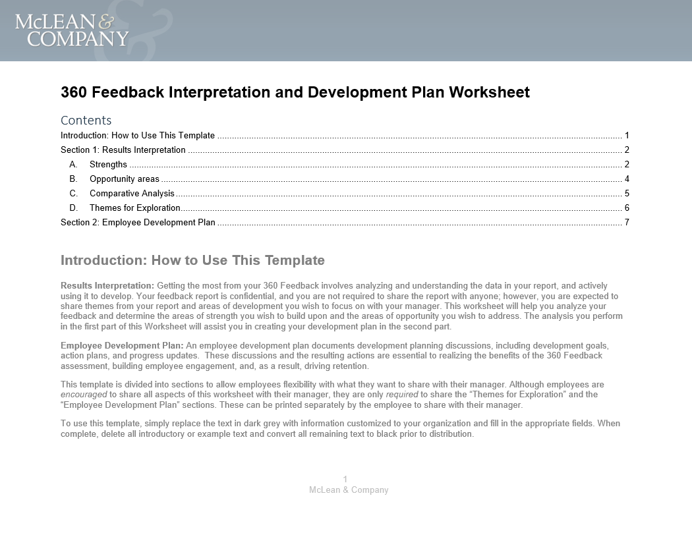
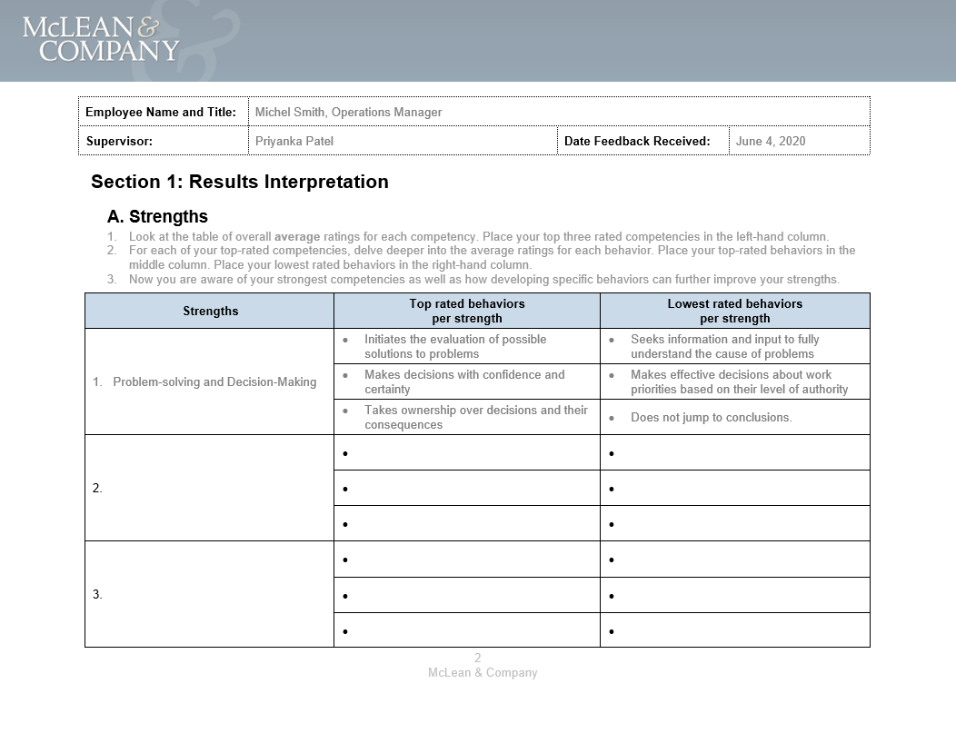
Use the 360 Feedback Interpretation and Development Plan Worksheet in tandem with this Job Aid
This tool will help you uncover themes for development and get the most out of your feedback in a structured way. Use the verbatim comments to help put the feedback in context.
Compare the numerical assessments for each competency by each rater group, including the self-assessment, to pinpoint differences in perception by rater groups.
Use McLean & Company’s 360 Feedback Interpretation and Development Plan Worksheet as a guide in interpreting your data.
The following slides contain more detailed guidance and examples on the following analyses:
Determine strengths:
Competencies or behaviors that scored high and should be leveraged and continued to be developed.
Determine opportunity areas:
Competencies or behaviors that were scored low and should be developed to improve.
Comparative analysis:
Competencies or behaviors that were scored inconsistently between raters and self-assessment
Themes for exploration:
Based on all the analysis, document key themes to be shared with your manager or coach to create a personal development plan.
Select two to three areas of development focus and document your initial thoughts on developmental goals.

Slide 4
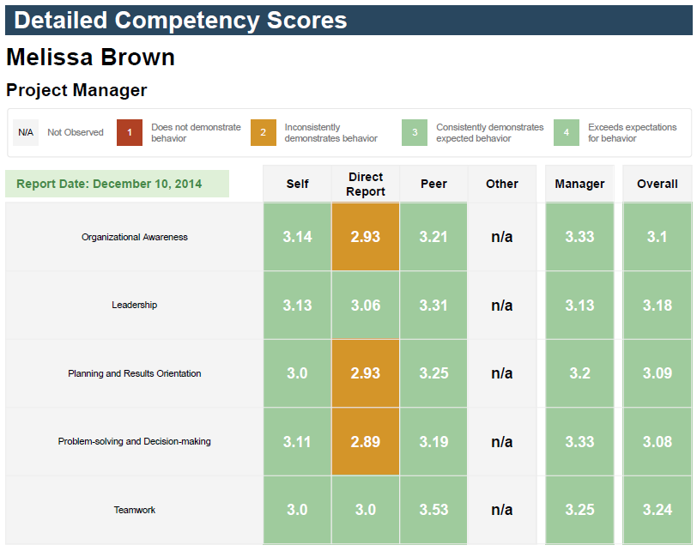
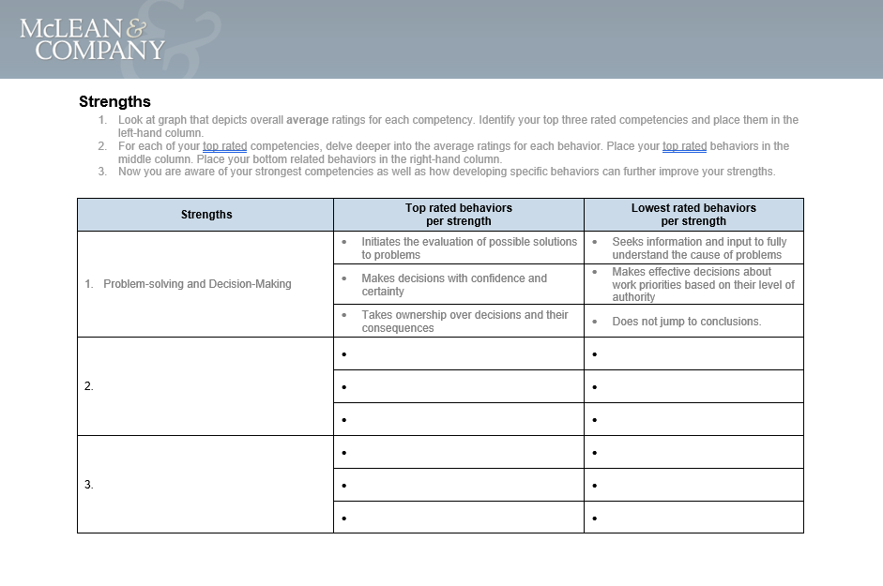
Determine strengths
Follow the instructions in the 360 Feedback Interpretation and Development Plan Worksheet to identify strengths in the 360 report.
From the “overall” column in your report, choose the top three rated competencies and document them in the worksheet.
List the top and lowest rated behaviors per strength.
1
01
2
02

Slide 5
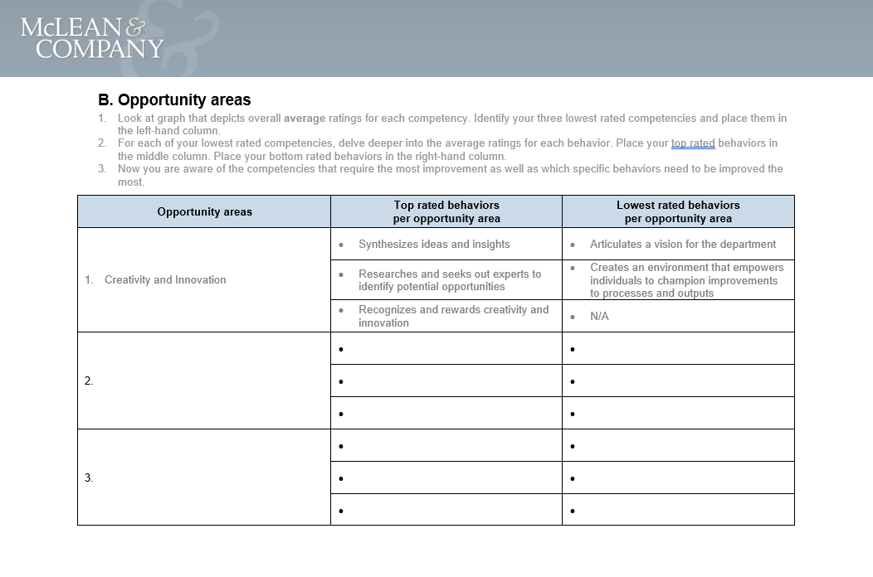
Determine opportunity areas
Follow the instructions in the 360 Feedback Interpretation and Development Plan Worksheet to identify opportunity areas in the 360 report.
From the “overall” column in your report, choose the three lowest rated competencies and document them in the worksheet.
List the top and lowest rated behaviors per opportunity area.
1
01
2
02

Slide 6
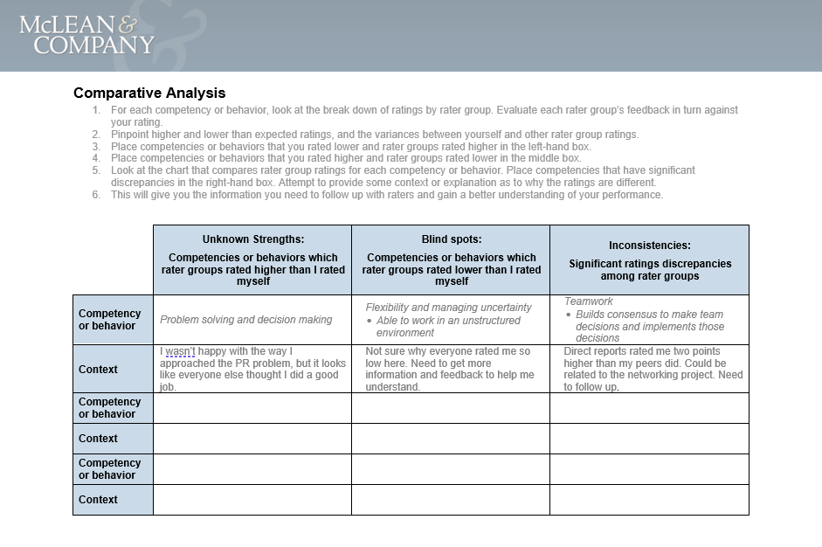
Do a comparative analysis of the feedback from different rater groups
Follow the instructions in the 360 Feedback Interpretation and Development Plan Worksheet to do a comparative analysis of your 360 Feedback Report.
For each competency or behavior, compare the self-rating with the other rater groups, noting where the ratings are higher or lower.
Follow the instructions in the “Comparative Analysis” section to document discrepancies between your rating and those of the rater groups. Take note of the following areas:
1
01
2
02
Unknown strengths
Competencies that rater groups rated higher than you rated yourself. These are strengths you didn’t know about.
Perception gaps
Competencies that rater groups rated lower than you rated yourself. These are opportunity areas you didn’t know about.
Inconsistencies
Significant rating discrepancies that exist among rater groups. These require further investigation by reviewing verbatim comments or having follow-up discussions with rater groups whose ratings differed.
NOTE: Do not try to decipher who said what as this undermines the confidentiality of the report and the culture of trust. The investigation is to determine what the root problem is behind the discrepancy (e.g. does your behavior differ when interacting with different groups?).

Slide 7
Determine themes for exploration
Follow the instructions in the 360 Feedback Interpretation and Development Plan Worksheet to determine themes for exploration.
From the “strengths” and “unknown strengths” lists, identify up to three competencies or behaviors that will most help you be successful in your current role and future career aspirations.
For example, if one of your strengths is decision making, and you know that you’ll likely be promoted to take on more decision-making responsibility in the near future, identify a way to continue growing this ability. This could involve scheduling time each week to do research for any decisions that may be difficult or complex, so you can continue to make decisions with confidence.
From the “opportunity areas” and “perception gaps” lists, identify up to three competencies or behaviors that will most help you be successful.
For example, if one of your opportunity areas is creativity and innovation and this is a competency that will be crucial to your career goals, identify specific actions you can take to grow in this area. This could include identifying sources that can help spark new ideas for your work (magazines, inspiring blogs, etc.) and scheduling 15 minutes once a week to read and jot down creative ideas you can develop further.
From the comparative analysis, identify up to three “inconsistencies” to follow up on. It is important to investigate these areas further to clarify where the opportunities for growth are. These can be included as additional strengths or opportunity areas (depending on what the investigation reveals) when building your development plan in the next section of this job aid.
For example, if the “direct report” rater group rated your ability to manage through change and uncertainty significantly lower than other rater groups, think of a time when you have found it challenging to navigate change and uncertainty with your direct reports. Identify what you could have done differently, such as improving communication of change initiatives and ensuring direct reports feel supported in adapting to change.
1
01
2
02
3
03
Once you have determined the themes for exploration, you will have a clear idea on how to prioritize your development plan based on the feedback received and your own career goals.

Slide 8
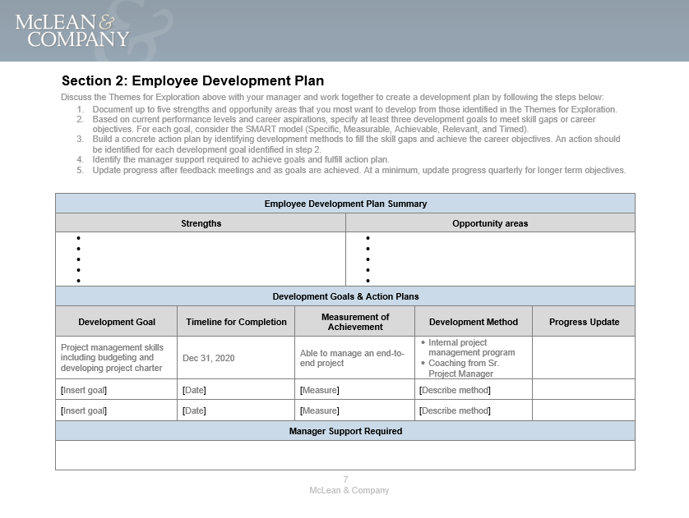
Work with your manager to create a concrete development plan
The 360 feedback process will only facilitate development if you follow through on the feedback given.
Meet with your manager to create and document a 360 feedback development plan. This will help increase accountability for your developmental activities.
Customize this slide with an image of your organization’s development plan if you prefer.
The 360 feedback development plan will detail:
Strengths and opportunity areas
Development goals
Development time frame
Development methods to achieve development goals
Manager support requirements
More information on creating an employee development plan is provided on the following slides.

Slide 9
Use an experiential learning first approach to development
Examples
Seek out a variety of opportunities to learn and practice new skills.
Experiential:
Relational:
Formal:
On-the-job learning opportunities that provide the chance to learn by doing.
Job rotation
Volunteer opportunities
Special projects
Stretch assignments
Opportunities where one can develop learning relationships with others.
Coaching
Mentoring
Peer mentoring
Structured learning and training programs or classroom delivery methods.
Lectures, seminars, workshops
Group discussions
Role playing
Live webinars and video conferences
eLearning
There are three main learning methods in which learning and development occurs: formal training, relational, and experiential.
McLean & Company recommends a blended approach to learning and development by using a combination of the formats.
Prioritize experiential learning when it comes to creating your development plan. Take a “learn by doing” approach to development activities and then support these through feedback from a mentor, formal training where needed, and self-reflection on how you learn best.

Slide 10
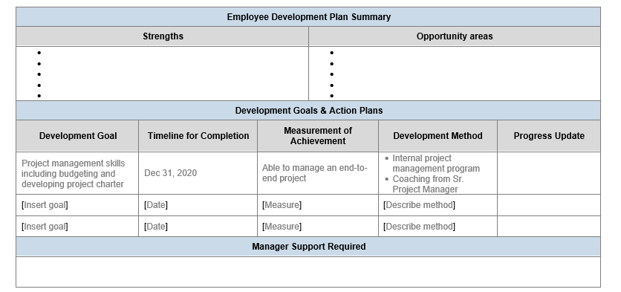
Create development goals that address skill gaps and align with career objectives
Follow the instructions in your 360 Feedback Interpretation and Development Plan Worksheet:
List up to five strengths and opportunity areas you most want to develop from those identified in the “Themes for Exploration” section of the Worksheet.
Based on current performance levels and career aspirations, specify at least three development goals to address skill gaps or career objectives.
For example, if an important opportunity area is organizational awareness, your goal could be to learn the competitive value of your organization’s core products and services.
1
01
2
02

Slide 11
Choose a measure of achievement and development method
3
03
Decide how developmental goal achievements will be measured.
For example, if the goal is to learn the competitive value of your organization’s core products and services, a measure of achievement might be giving a short summary of this topic to a client on a call.
Next, identify a development method and remember to prioritize experiential learning.
For example, for the above goal, you could give a presentation to new employees on the competitive value of your organization’s core products and services to practice speaking confidently and competently about this topic.
4
04

Slide 12
Finally, formalize the goals, timeline, and progress check-ins with your manager
Set SMART development goals for each competency that needs to be developed.
After discussing development goals and action items with your manager, formalize how and when progress will be reviewed to ensure accountability.
Establish timelines for reviewing progress and confirm how development progress will be measured.
As a general guideline, ensure that one-on-one check-ins are occurring at least once a month.
Document goals, timelines, and check-ins in the 360 Feedback Interpretation and Development Plan Worksheet.
S
Specific: Exactly what do you want to accomplish?
M
Measurable: How will you demonstrate success?
A
Actionable: Is this an achievable outcome?
R
Relevant: How is the goal tied to your overall objective for development?
T
Time-bound: When will this goal be accomplished by?

Slide 13
Next steps
1
Review report
Review your report and fill out the interpretation worksheet.
2
Discuss themes
Meet with [HR or your coach] to discuss your development feedback themes.
3
Create plan
Meet with your manager to share themes and create a development plan.
4
Close loop
Close the loop with those who provided feedback. Thank them for their input, and if you feel comfortable, share feedback themes and action plans.
5
Check-in
Set checkpoints with [HR, your manager, or your coach] to discuss progress against the development plan.

